Slide 1
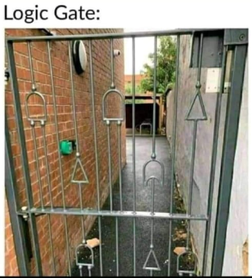
Functions of
Combinational Logic
Chapter 6
Week 1
Sumaiyah Zahid

Slide 2
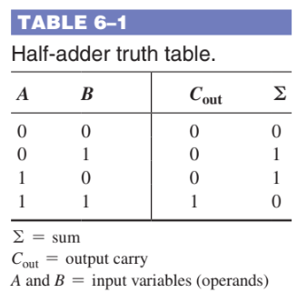
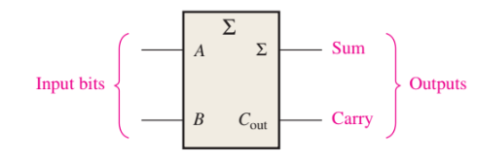
Half Adder

Slide 3
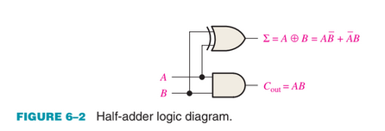
Half Adder

Slide 4
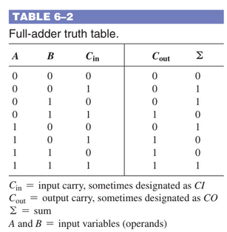
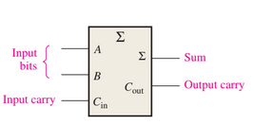
Full Adder

Slide 5
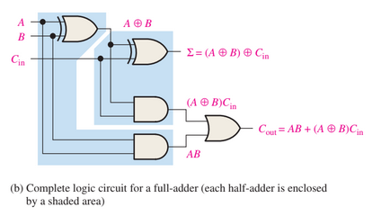
Full Adder

Slide 6
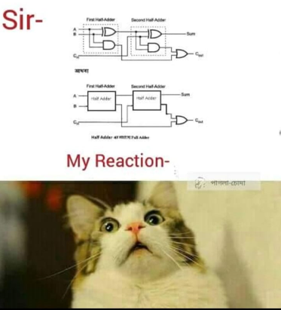
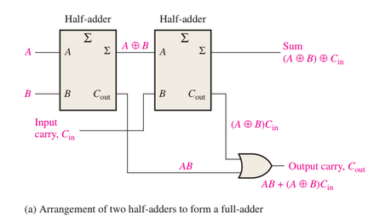
Full Adder from 2 Half Adder

Slide 7
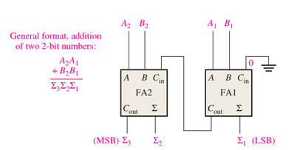
2 Bit Addition

Slide 8
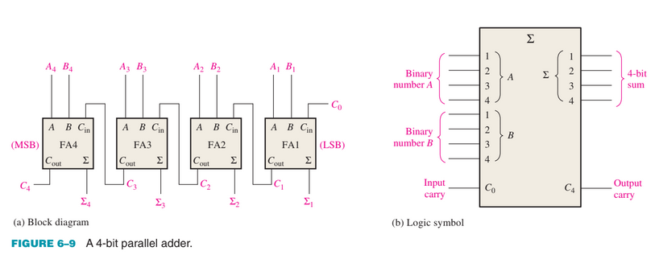
4 Bit Addition

Slide 9
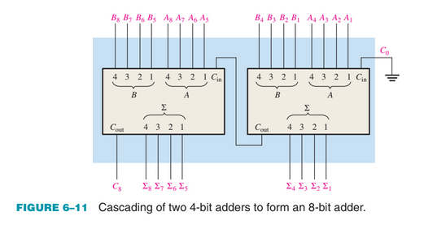
8 Bit Addition

Slide 10
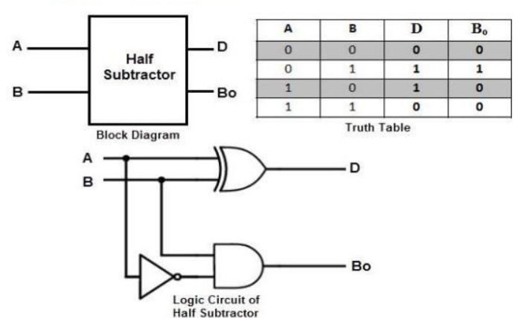
Half Subtractor

Slide 11
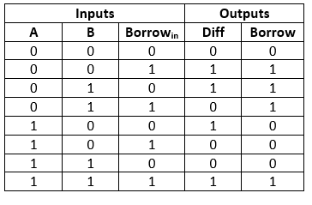
Full Subtractor

Slide 12
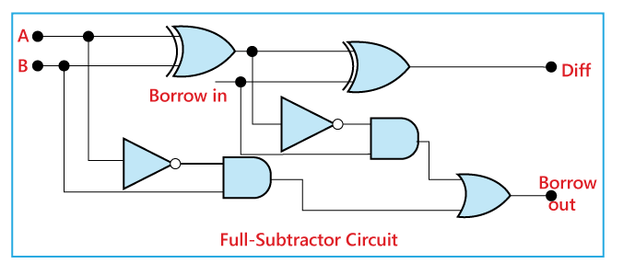
Full Subtractor

Slide 13
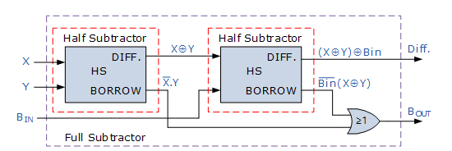
Full Subtractor From Half SUbtractor

Slide 14
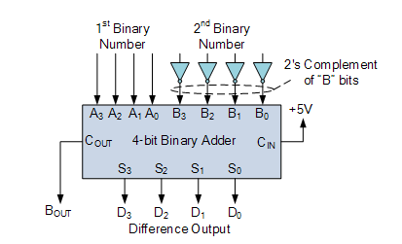
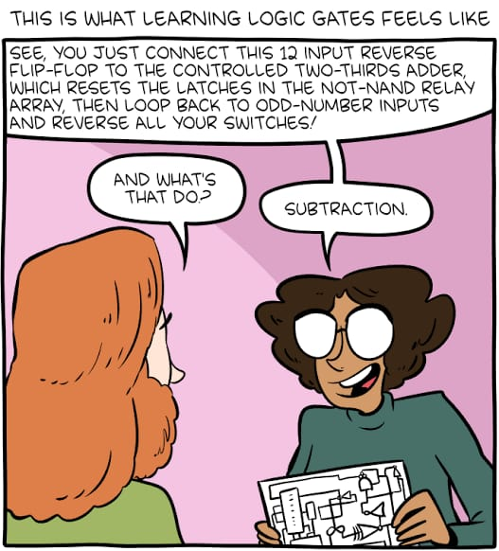
Binary Subtractor Using 2’s Complement

Slide 15
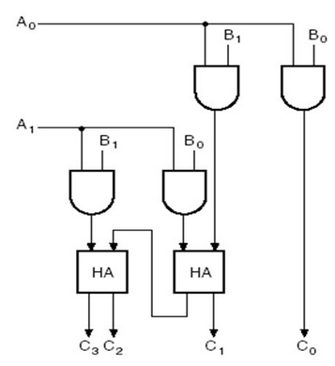
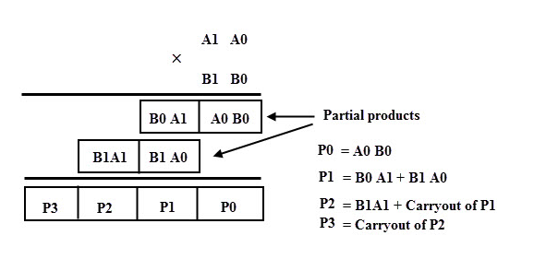
Binary Multiplication

Slide 16
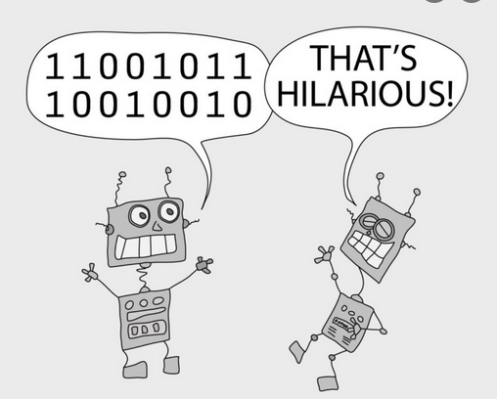
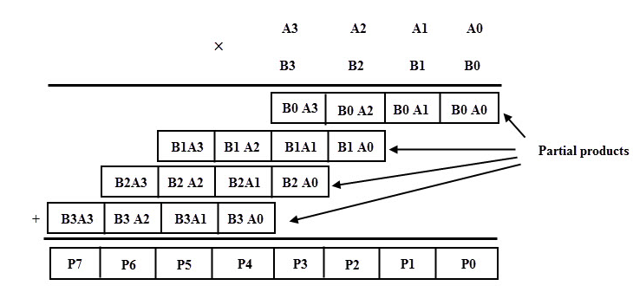
Binary Multiplication

Slide 17
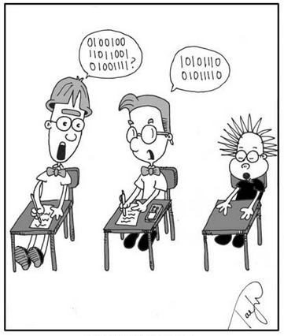
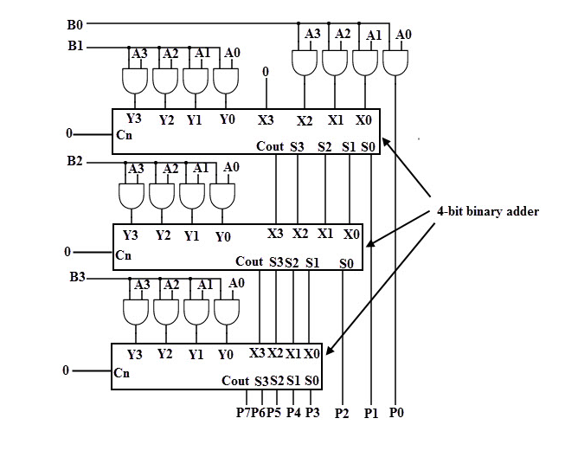
Binary Multiplication

Slide 18
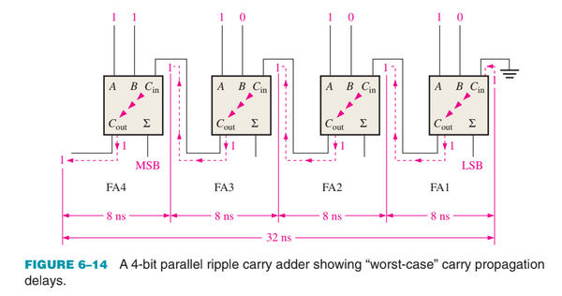
Ripple carry Adders
Solution is Look Ahead Carry Adder

Slide 19
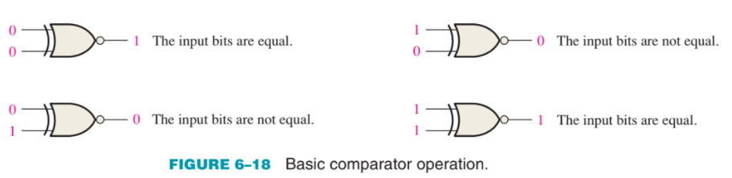
Comparators

Slide 20
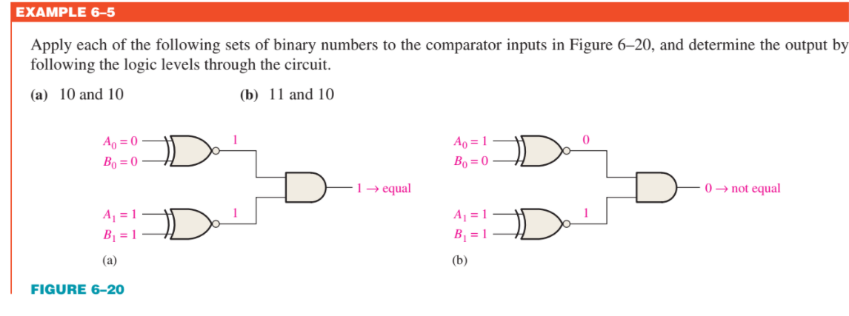
Comparators

Slide 21
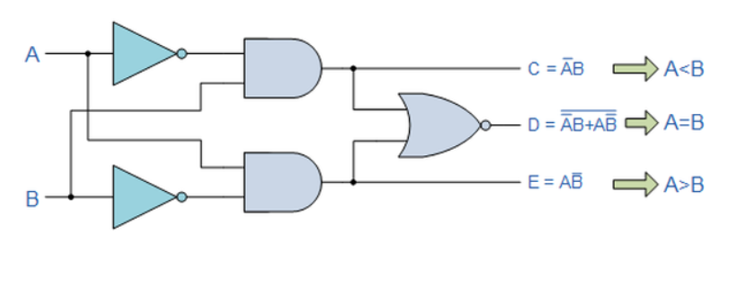
1 Bit Comparators

Slide 22
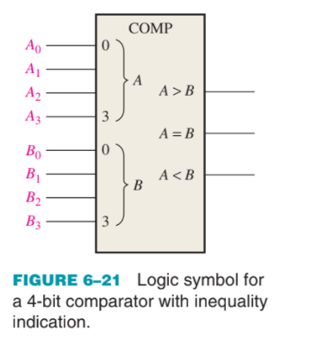
4 Bit Comparators
1. If A3 = 1 and B3 = 0, number A is greater than number B.
2. If A3 = 0 and B3 = 1, number A is less than number B.
3. If A3 = B3, then you must examine the next lower bit position for an inequality.

Slide 23
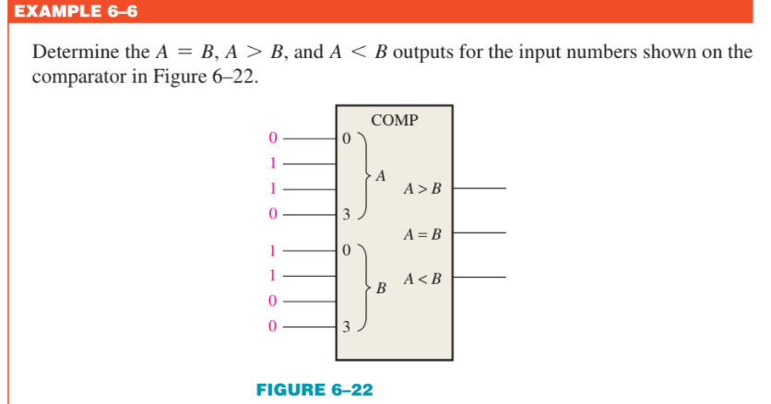
4 Bit Comparators

Slide 24


Decoders
Me : Ammi aj doston k sath sehri bahar karunga
Ammi:

Slide 25
Decoders
A decoder is a digital circuit that detects the presence of a specified combination of bits (code) on its inputs and indicates the presence of that code by a specified output level.
a decoder has n input lines to handle n bits and from one to 2^n output lines

Slide 26
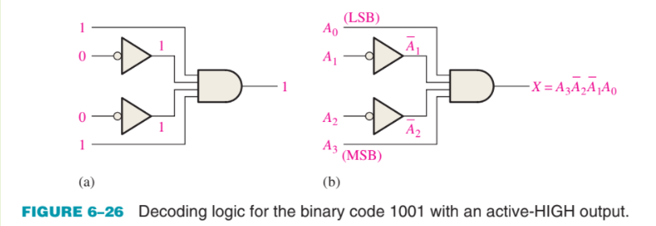
Basic Binary Decoder
Determine the logic required to decode the binary number 1011 by producing a HIGH level on the output.

Slide 27
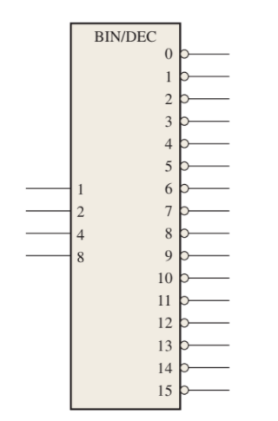
4 Bit Decoder
To decode all possible combinations of four bits, sixteen decoding gates are required (2^4 = 16).
4-line-to-16-line decoder because there are four inputs and sixteen outputs
1-of-16 decoder because for any given code on the inputs, one of the sixteen outputs is activated.

Slide 28
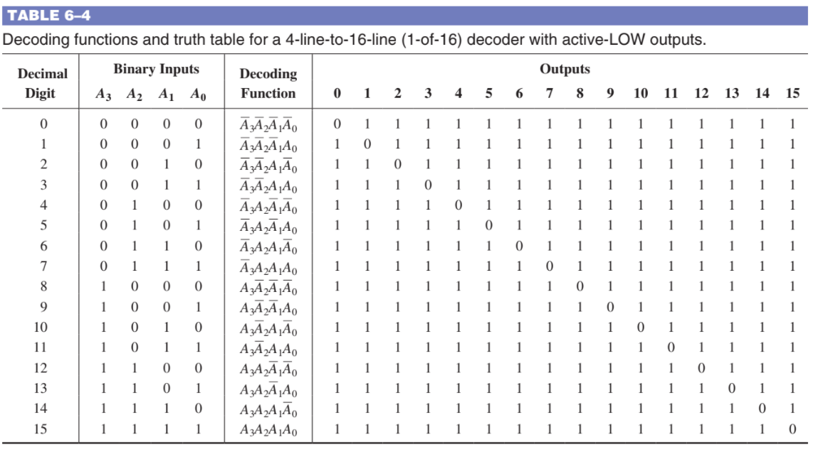
4 Bit Decoder

Slide 29
Home Task
Design a 3-line-to-8-line decoder can be used for binary-to-octal decoding.

Slide 30
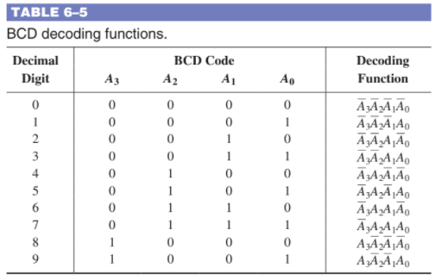
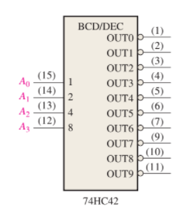
BCD To DEcimal Decoder

Slide 31
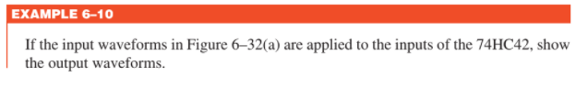
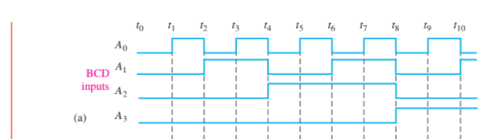
BCD To DEcimal Decoder

Slide 32
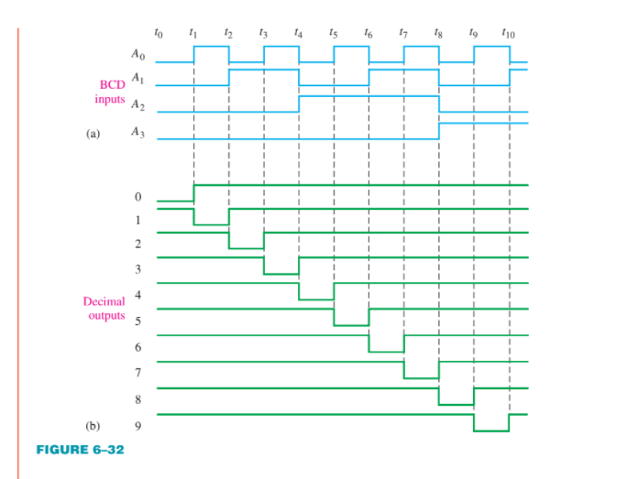
BCD To DEcimal Decoder

Slide 33
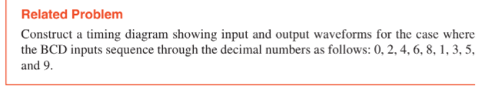
BCD To DEcimal Decoder

Slide 34
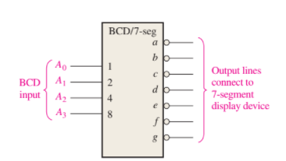
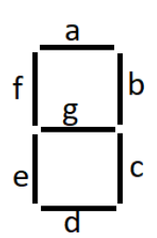
BCD To 7-Segment Decoder

Slide 35
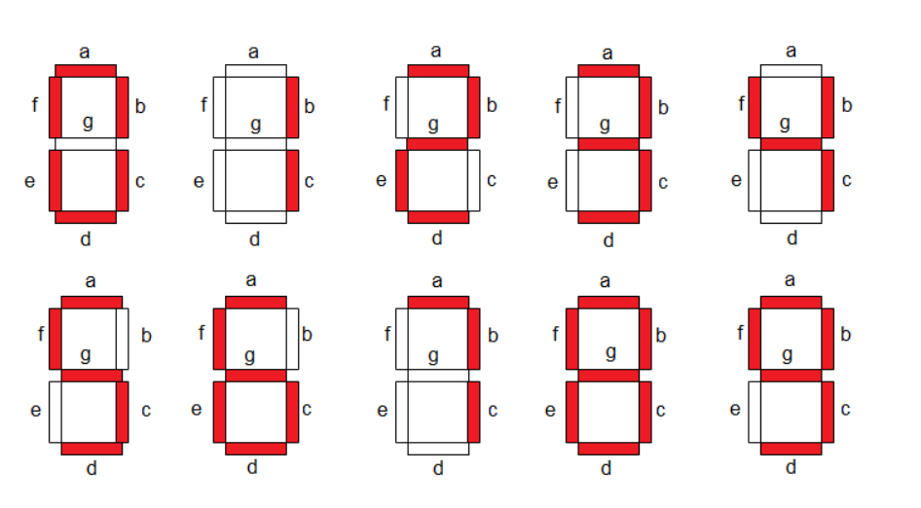
BCD To 7-Segment Decoder

Slide 36
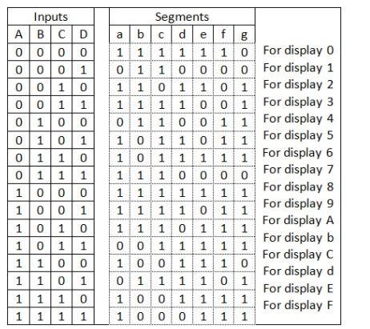
BCD To 7-Segment Decoder

Slide 37
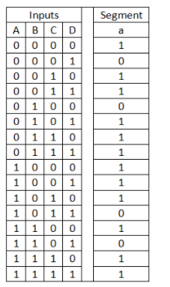
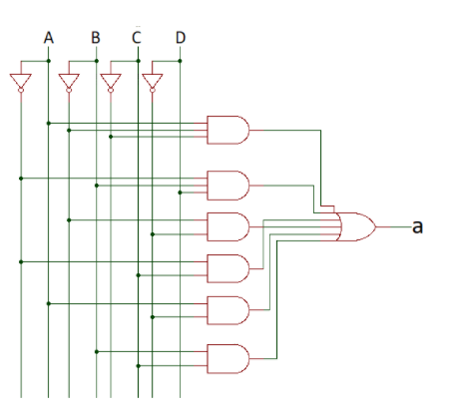
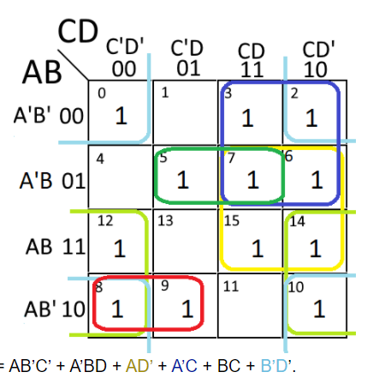
BCD To 7-Segment Decoder
For segment ‘a’

Slide 38
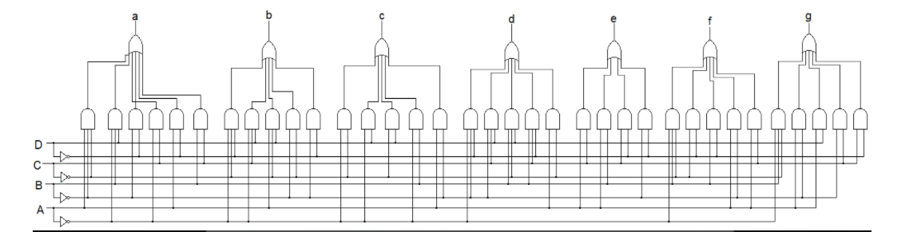
BCD To 7-Segment Decoder
https://electronics-fun.com/7-segment-hex-decoder/

Slide 39
Encoders
Reverse Decoder
The process of converting from familiar symbols or numbers to a coded format is called encoding.
Applications: Keypad-binary numbers

Slide 40
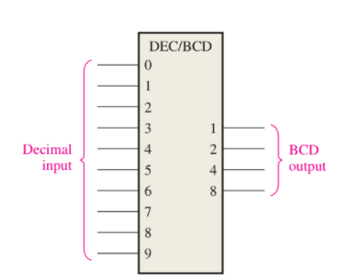
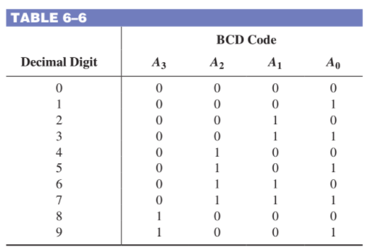
Decimal to BCD Encoders

Slide 41
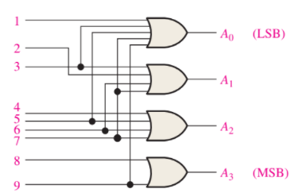
Decimal to BCD Encoders

Slide 42
Decimal to BCD Priority Encoders
The priority function means that the encoder will produce a BCD output corresponding to the highest-order decimal digit input that is active.
For instance, if the 6 and the 3 inputs are both active, the BCD output is 0110 (which represents decimal 6).

Slide 43
Code Converter
BCD-to-Binary Conversion:
1. The value, or weight, of each bit in the BCD number is represented by a binary number.
2. All of the binary representations of the weights of bits that are 1s in the BCD number are added.
3. The result of this addition is the binary equivalent of the BCD number.
The binary numbers representing the weights of the BCD bits are summed to produce the total binary number.

Slide 44



BCD-to-Binary Conversion

Slide 45

Binary-to-Gray and Gray-to-Binary Conversion
How many exclusive-OR gates are required to convert 8-bit binary to Gray?

Slide 46
MultiPlexers (MUX)
Allows digital information from several sources to be routed onto a single line for transmission over that line to a common destination.
It has several data-input lines and a single output line.
It also has data-select inputs, which permit digital data on any one of the inputs to be switched to the output line.
Also known as data selectors.
Applications: Router, Telephone Network, Computer memory

Slide 47



MultiPlexers (MUX)

Slide 48



MultiPlexers (MUX)

Slide 49


MultiPlexers (MUX)

Slide 50

MultiPlexers (MUX)

Slide 51

8 Bit MUX IC

Slide 52

16 Bit Mux using 8 Bit Mux IC

Slide 53
Home Task
Make a block diagram to implement 16 bit MUX using 4 bit MUX IC.

Slide 54

MultiPlexers (MUX)

Slide 55

MultiPlexers (MUX)

Slide 56

MultiPlexers (MUX)

Slide 57

MultiPlexers (MUX)

Slide 58

De-Multiplexers (DEMUX)
A (DEMUX) basically is reverse multiplexer.
It takes digital information from one line and distributes it to a given number of output lines.
Also known as a data distributor.

Slide 59


De-Multiplexers (DEMUX)
Applications: Router, FM radio, Serial-to-Parallel Converter

